Slide 1
Bread Financial Overview

Slide 2

Bread Product Offerings:
Bread financials major product offerings:
Credit Cards
Loans (BNPL)
Deposits

Slide 3
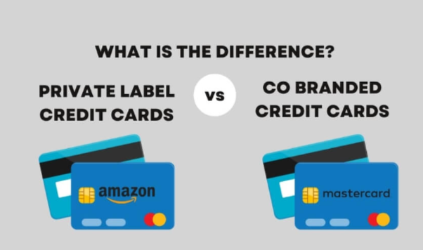
Types of Credit Cards
Card Type | Where It Works | Network Logo | Perks
Private Label Card (PLCC) | Only at issuing retailer | Usually no major network (store-only) | Store-specific discounts, loyalty perks
Co-Branded Card | At partner brand + anywhere network accepted | Yes (Visa/Mastercard) | Brand rewards + standard network benefits

Slide 4
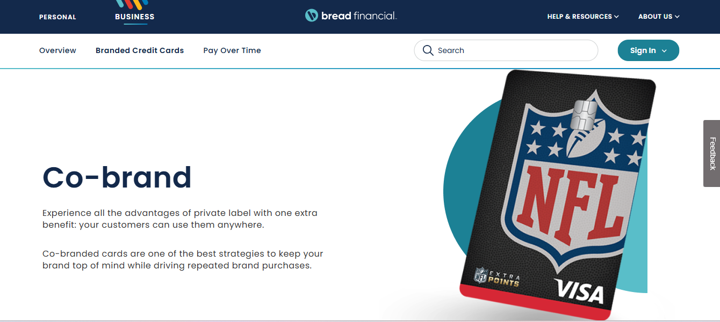

Slide 5
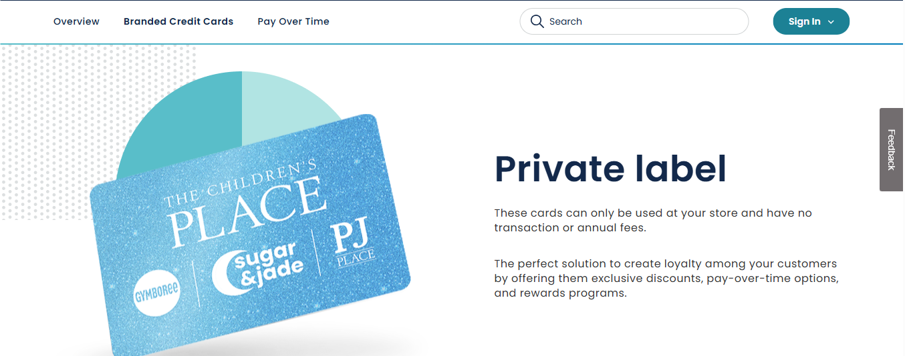

Slide 6
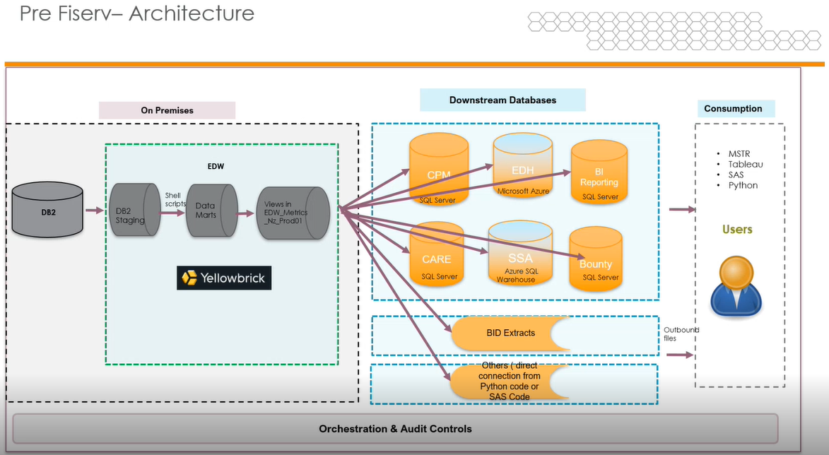
Architecture

Slide 7
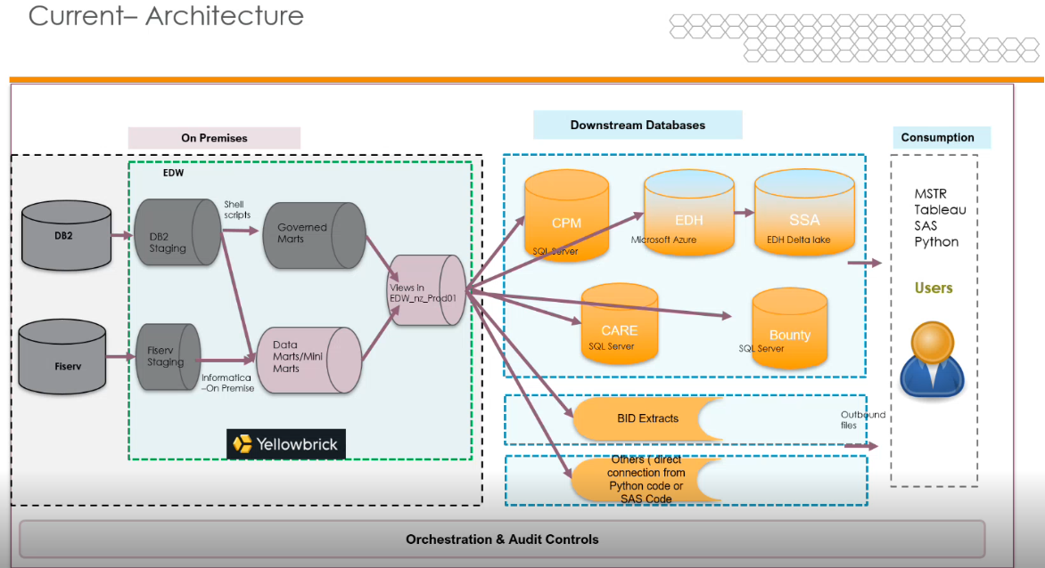

Slide 8
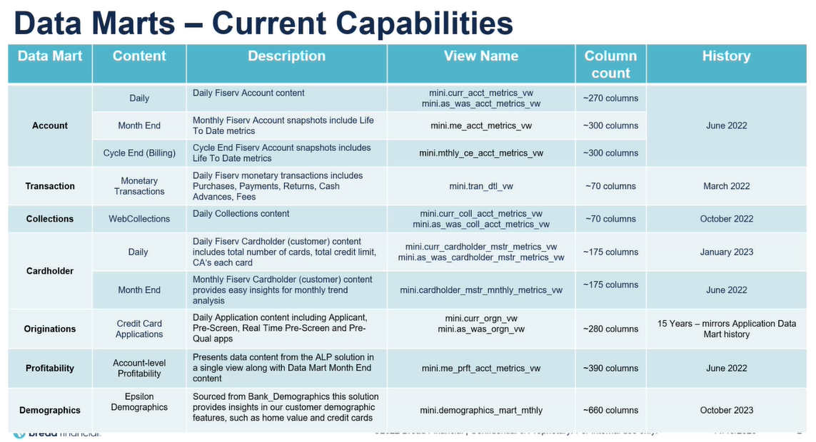

Slide 9
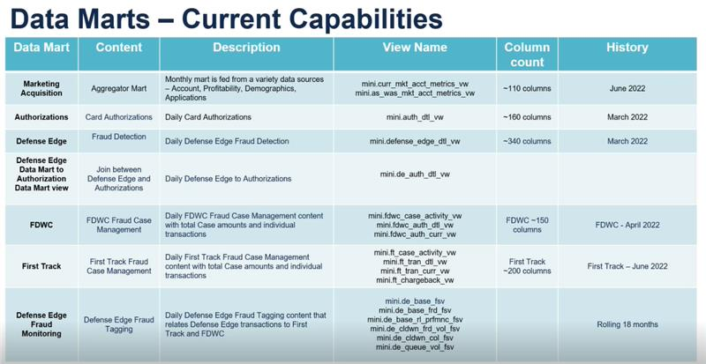

Slide 10
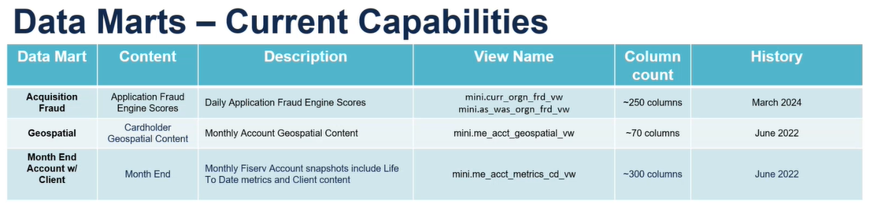

Slide 11
Thank you

